Slide 1

Individual homework Logic circuits Exercise 4
Dan Radu-Anton
Group 912

Slide 2
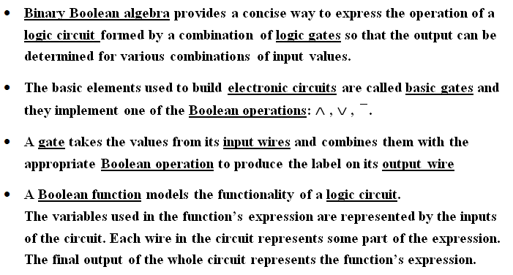
Theoretical results Definition of logic circuits

Slide 3
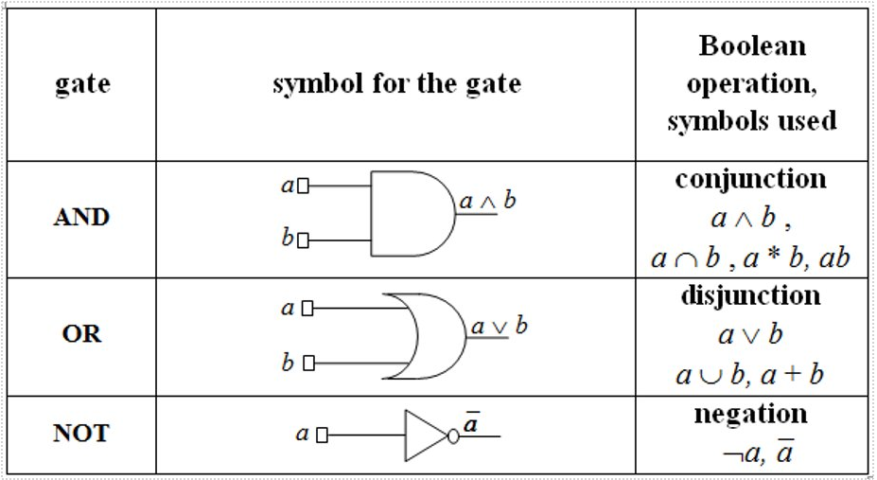
Theoretical results Basic gates

Slide 4
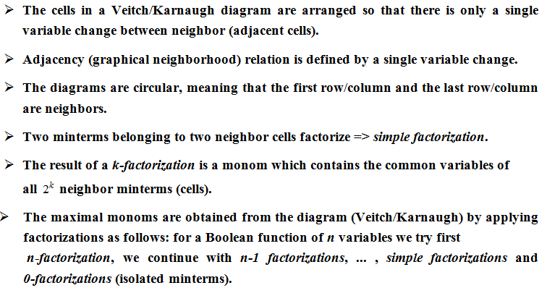
Theoretical results Veitch/Karnaugh diagrams

Slide 5
Solving the exercise Writing the function
x1 | x2 | x3 | x4 | f
0 | 0 | 0 | 0 | 1
0 | 0 | 0 | 1 | 1
0 | 0 | 1 | 0 | 0
0 | 0 | 1 | 1 | 1
0 | 1 | 0 | 0 | 0
0 | 1 | 0 | 1 | 1
0 | 1 | 1 | 0 | 0
0 | 1 | 1 | 1 | 0
1 | 0 | 0 | 0 | 0
1 | 0 | 0 | 1 | 1
1 | 0 | 1 | 0 | 0
1 | 0 | 1 | 1 | 1
1 | 1 | 0 | 0 | 0
1 | 1 | 0 | 1 | 0
1 | 1 | 1 | 0 | 0
1 | 1 | 1 | 1 | 0
We have to obtain the disjunctive form of the output from the
table of values
f(x1, x2, x3, x4) =
= m0 v m1 v m3 v m5 v m9 v m11 =
= $\overline{x1} \overline{x2}$ $\overline{x3} \overline{x4}$ V $\overline{x1}$ $\overline{x2}$ $\overline{x3}$ $x4$ V $\overline{x1}$ $\overline{x2} x3 x4$ V $\overline{x1}$ $x2 \overline{x3} x4$V
V $x1 \overline{x2}$ $\overline{x3} x4$ V $x1 \overline{x2} x3 x4$

Slide 6
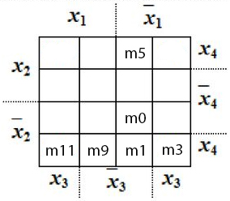
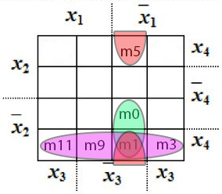
Solving the exercise Building the Veitch diagram

Slide 7
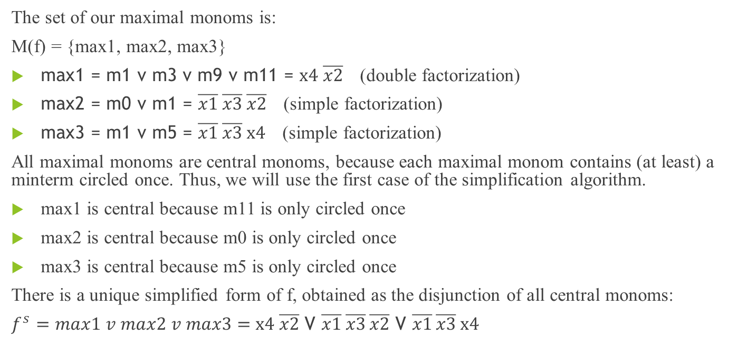
Solving the exercise Simplifying the Boolean function
The set of our maximal monoms is:
M(f) = {max1, max2, max3}
max1 = m1 v m3 v m9 v m11 = x4 $\overline{x2}$ (double factorization)
max2 = m0 v m1 = $\overline{x1}$ $\overline{x3}$ $\overline{x2}$ (simple factorization)
max3 = m1 v m5 = $\overline{x1}$ $\overline{x3}$ x4 (simple factorization)
All maximal monoms are central monoms, because each maximal monom contains (at least) a minterm circled once. Thus, we will use the first case of the simplification algorithm.
max1 is central because m11 is only circled once
max2 is central because m0 is only circled once
max3 is central because m5 is only circled once
There is a unique simplified form of f, obtained as the disjunction of all central monoms:
$f^{s}=max1 v max2 v max3=$x4 $\overline{x2}$ V $\overline{x1}$ $\overline{x3}$ $\overline{x2}$ V $\overline{x1}$ $\overline{x3}$ x4

Slide 8
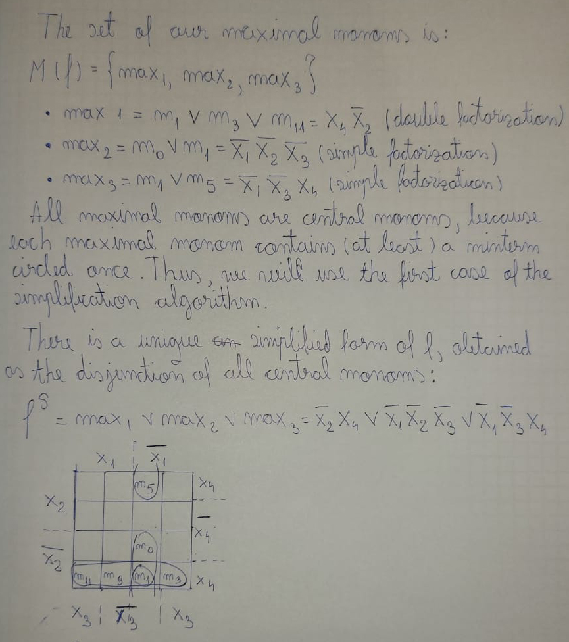
Solving the exercise Simplifying the Boolean function - handwritten

Slide 9
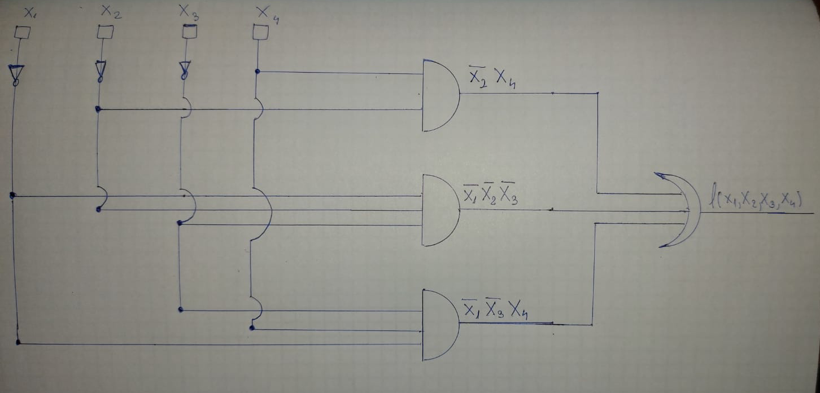
Conclusion The logic circuit
NOT
x4
NOT
NOT
A
N
D
$\overline{x2}$
$\overline{x1}$
A
N
D
$\overline{x2}$
$\overline{x3}$
OR
$\overline{x3}$
A
N
D
x4
$\overline{x1}$
$f^{s}=max1 v max2 v max3=$x4 $\overline{x2}$ V $\overline{x1}$ $\overline{x3}$ $\overline{x2}$ V $\overline{x1}$ $\overline{x3}$ x4

Slide 10
Thank you for your attention!

